Slide 1
Cypress

Slide 2

02
Introduction to Cypress
Understanding the Testing Framework
Overview of Cypress as a testing framework: Cypress is a modern JavaScript-based testing framework that empowers developers and QA teams to write both unit tests and end-to-end tests. Unlike traditional testing solutions, Cypress runs in the same run-loop as the application, providing unparalleled access to everything in your application and allowing immediate feedback.
Importance of end-to-end testing: End-to-end testing is crucial for verifying that an application behaves as expected from the user's perspective. It simulates real user scenarios to ensure that all components of the application work together harmoniously, significantly reducing the likelihood of defects reaching production.
Brief history and evolution of Cypress: Originally created to address shortcomings in other testing frameworks, Cypress has rapidly evolved since its inception in 2014. It has garnered a dedicated following due to its user-centric design that enhances developer productivity and offers an intuitive interface.

Slide 3
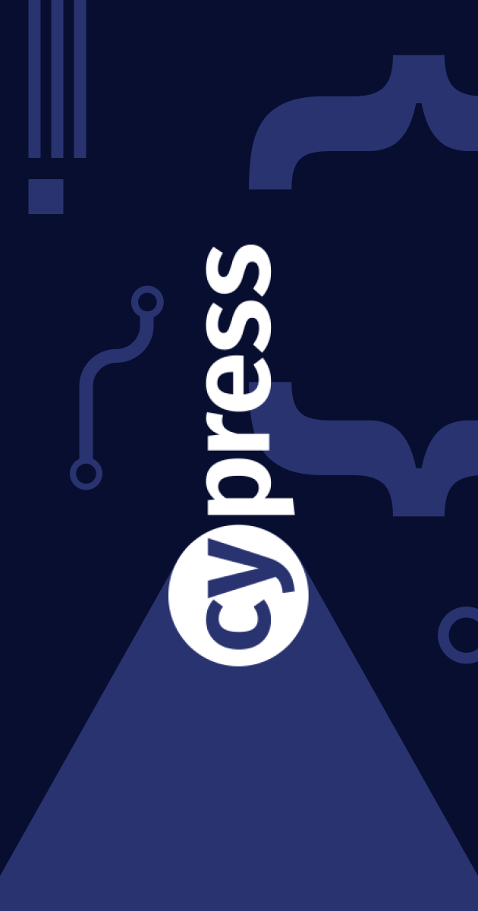


03
System requirements for Cypress
Cypress can run on macOS, Windows, and Linux. It requires Node.js version 12 or higher, as well as a modern web browser such as Chrome, Firefox, or Electron for optimal performance and compatibility.
Cypress Setup and Installation
Step-by-step installation guide
Cypress can be installed easily using npm or Yarn. The typical command is 'npm install cypress --save-dev', which will integrate Cypress with your existing project and allow for straightforward updates and maintenance.
Configuration settings and initial setup
Once installed, Cypress can be configured through the cypress.json' file. This allows users to specify base URLs, write custom configurations, and establish project-specific settings to tailor the testing environment.

Slide 4
Key Features of Cypress
04
Harnessing Cypress Capabilities for Effective Testing
Real-time reloads and debugging Cypress
offers a unique development experience through real-time reloading. As changes are made in code, tests automatically rerun, providing instant feedback. Powerful debugging tools, like time-travel debugging, offer insights IntO every step of test execution with ease
Automatic waiting and retries Cypress
intelligently handles waiting for elements, eliminating the need for manual timeouts. It retries commands and assertions until they pass, ensuring stability in dynamic web applications where elements may not be immediately available.
Time travel and snapshots
A standout feature of Cypress is its ability to take snapshots of application state at each step of a test. This allows developers to visually inspect what the application looked like at any point in the execution, essential for diagnosing failures effectively.

Slide 5



05
Real World Applications of Cypress
Cypress in Action Across Industries
Case studies of companies using Cypress
Types of applications best suited for Cypress
Benefits observed in real-world scenarios
Prominent organizations across various sectors, including technology, e-commerce, and healthcare, employ Cypress to streamline their testing processes. These case studies highlight significant improvements in test reliability and development speed post- Cypress integration.
Cypress excels in testing single- page applications (SPAs) and modern web applications that rely on rich JavaScript frameworks such as React, Angular, or Vue. Its design allows comprehensive testing of Ul interactions that these applications entail.
Companies utilizing Cypress often report reduced testing time and increased developer productivity Faster feedback loops lead to quicker project iterations, enabling businesses to respond rapidly to market needs and enhance customer satisfaction

Slide 6
Challenges in using Cypress
06
Limitations of Cypress compared to other frameworks
While Cypress offers substantial advantages, it is primarily limited to testing in a browser context, which may deter the testing of non-browser environments, such as mobile apps or backend systems. This may necessitate the use of supplementary testing frameworks for comprehensive coverage
Common pitfalls and troubleshooting tips
Users may encounter challenges such as flaky tests, incorrect tests due to asynchronous behaviors, or configuration issues. Best practices encourage solid commands to reduce flakiness and robust logging for troubleshooting errors efficiently
Scalability issues in large projects
As testing suites grow larger, maintaining organization and performance becomes critical. Cypress can encounter performance issues with extensive test suites, highlighting the need for strategic organization and optimization in a testing strategy.

Slide 7
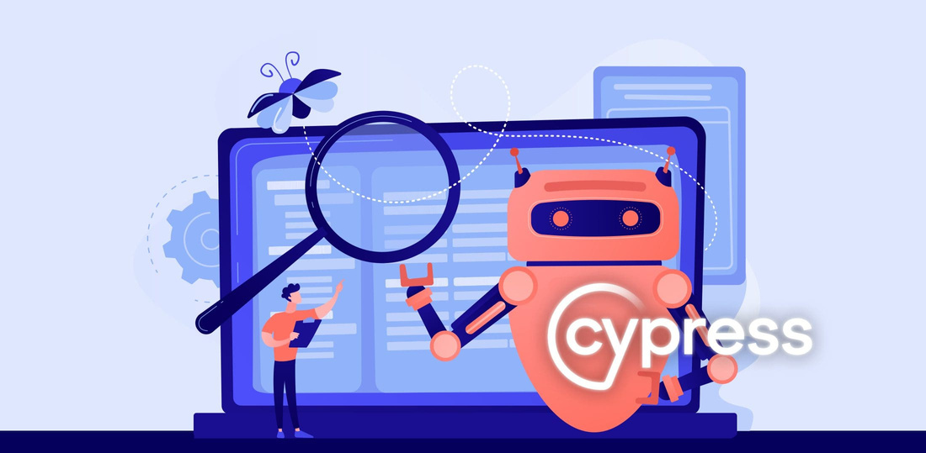
Best Practices for Cypress Testing
07
Organizing test files and folders A logical structure for test files promotes clarity and makes it easier to locate and maintain tests. Utilizing a consistent naming convention and separating tests based on functionality or feature areas can significantly improve overall organization.
Writing maintainable tests Ensuring tests are clear, concise, and focused on specific functionality enhances long-term maintainability Employing clean syntax and proper assertions will result in robust tests that can adapt to code changes without extensive rewrites.
Using custom commands and plugins Leveraging Cypress commands and plugins can simplify complex testing tasks, making tests more readable and reducing code duplication. By encapsulating common logic and utilities, teams can enhance efficiency and code cleanliness.

Slide 8
Future of Cypress and Testing Frameworks
08
Innovation on the Horizon
Upcoming features and enhancements
The Cypress team is actively working on new features that include better support for mobile and cross-browser testing, as well as enhanced dashboard capabilities. These updates will broaden the applicability of Cypress across various platforms,
Cypress's role in the evolving landscape
Cypress is strategically positioned to adapt to the shifting paradigms in software testing. Its philosophy of developer-first testing aligns with the growing emphasis on continuous delivery and DevOps practices in modern development environments
Trends in testing frameworks
As testing continues to evolve, the integration of artificial intelligence and machine learning is becoming prominent. Future frameworks including Cypress, are expected to incorporate intelligent testing strategies that will improve automation efficiency and accuracy

Slide 9
Conclusion and Key Takeaways
09
Summarizing the Cypress Experience
Summary of Cypress's strengths and weaknesses Cypress shines in its simplicity, speed, and intuitive setup, making it a preferred choice for many developers. However, its browser-centric approach and challenges in large-scale applications should be taken into account.
Encouragement to explore Cypress further As the landscape of web testing evolves, so does Cypress. Developers and teams are encouraged to actively experiment with its features, engaging with the community to unlock its full potential.
Final thoughts on implementation Implementing Cypress effectively requires understanding its ecosystem and embracing best practices Equipping teams with proper training and resources will ensure a smoother adoption process

Slide 10
10
Thank You!
June 2025

